Slide 1
The Balloons Game
Katerina Slavova

Slide 2
Explanations
Targeting group
What was my goal when creating the idea?
How the game works?

Slide 3
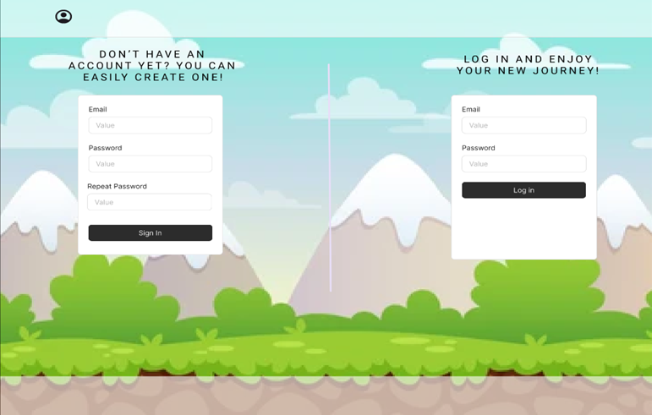
Sign in/ Log in page

Slide 4
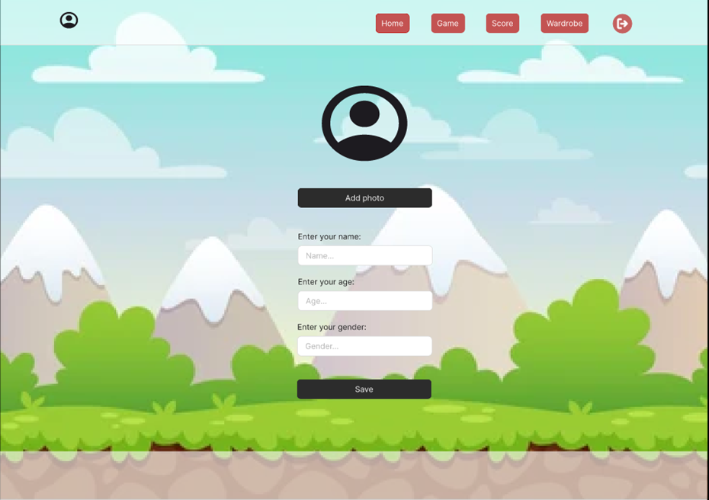
Settings

Slide 5
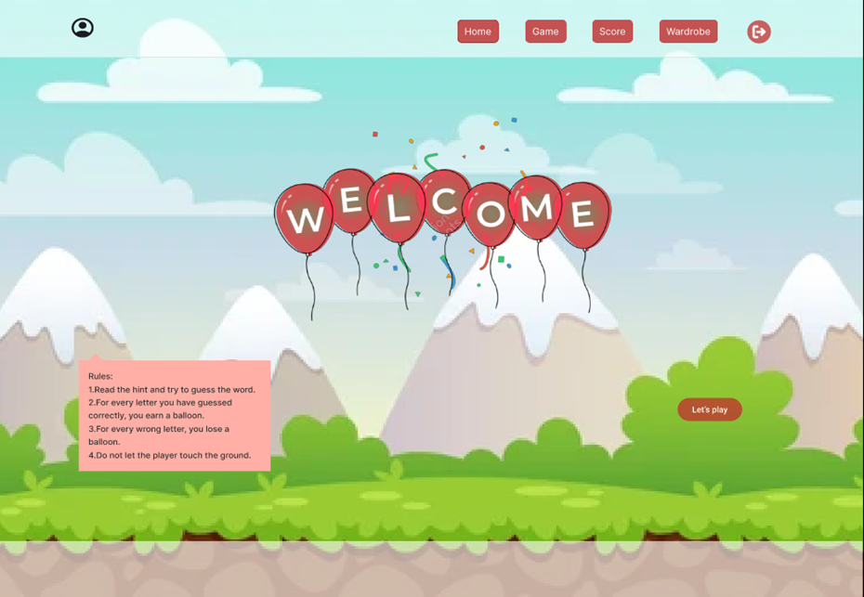
Home page

Slide 6
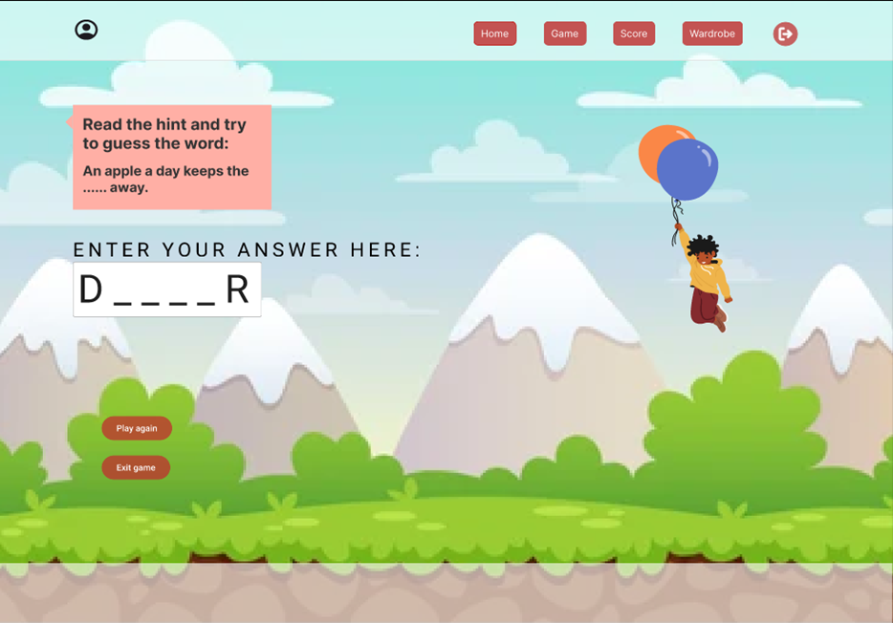
Game

Slide 7
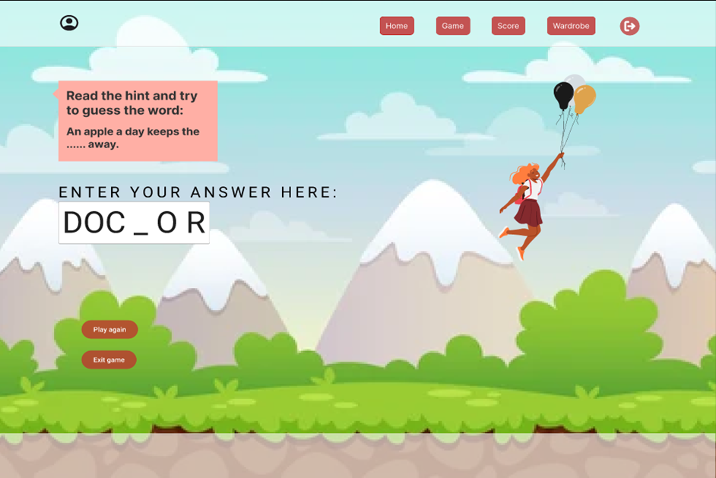
Game – correct letters entered

Slide 8
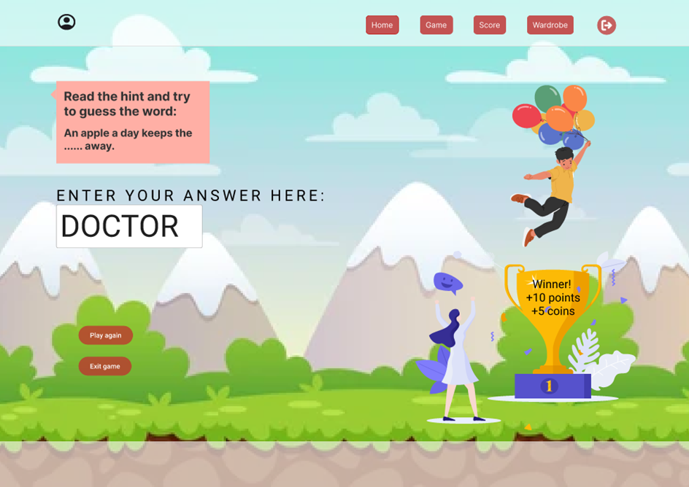
Game – when the word is guessed correctly

Slide 9
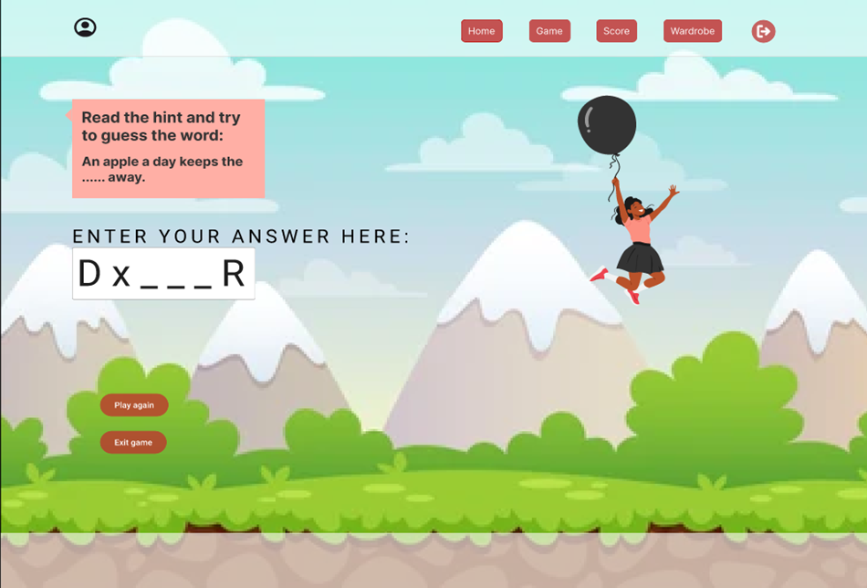
Game – wrong letter entered

Slide 10
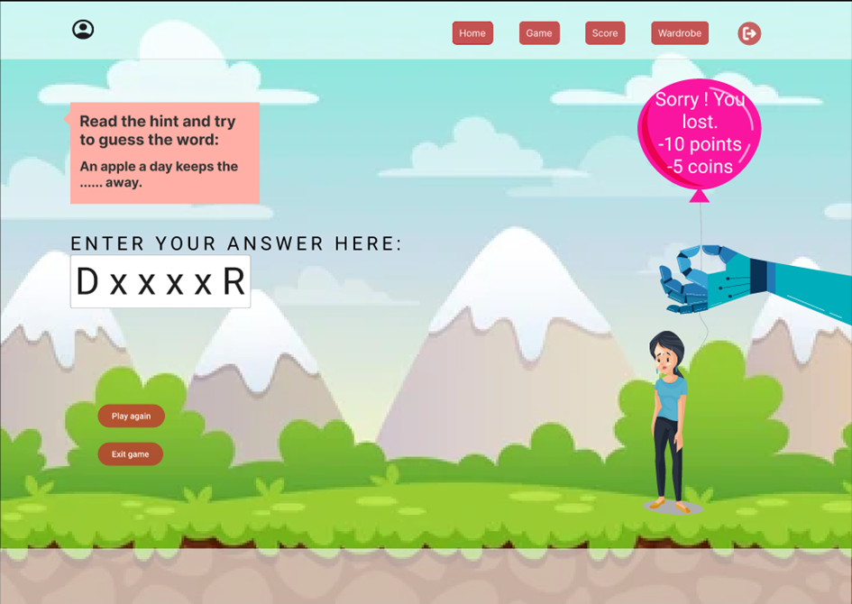
Game – when you lose all your balloons

Slide 11
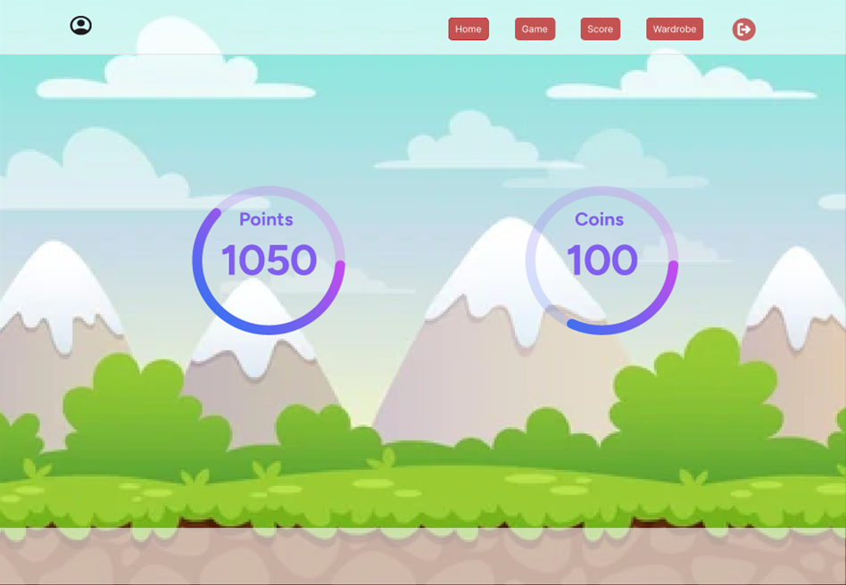
Score page

Slide 12
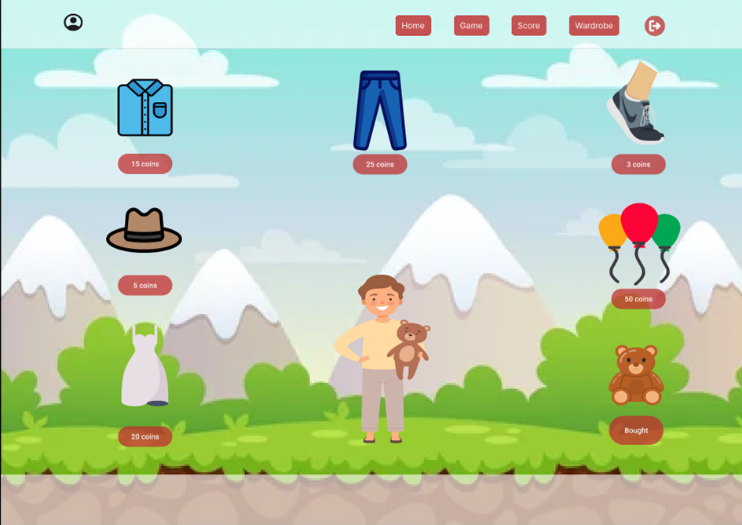
Wardrobe page

Slide 13
What I plan to improve?

